Slide 1
Reaction times

Slide 2
Nerve Cells
Responding to stimuli
A simple model of your nervous system is a stimulus– response model.
Receptors stimulate the sensory nerves.
The sensory nerves send a message to the brain.
The brain works out the response that is required, then sends a message along motor nerves to the effectors—the muscles or glands that will put the response into effect. Figure 7.1.15 provides an example

Slide 3
Reaction Times
Purpose
To calculate the reaction time for a simple task.
Materials
• metre ruler

Slide 4
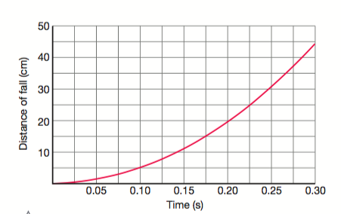

Slide 5
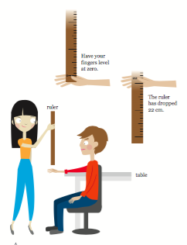
Work in pairs.
The person being tested (the subject) should sit with their elbow resting on the edge of a table.
The other person (the investigator) holds the ruler by the 100 cm mark so that it hangs vertically, with the 0 cm mark between the thumb and forefinger of the subject

Slide 6
When the investigator releases the ruler, the subject tries to catch it as quickly as possible, using just their thumb and finger.
Record the distance the ruler has fallen, and convert it to ‘time’ using the graph
Repeat the experiment five times to determine an average reaction time. You may wish to compare the times for left and right hands.

Slide 7
Results
Enter the data into a suitable table or spreadsheet, and calculate the average reaction time.
Discussion
a) Compare your reaction time with those of other students.
b) Propose reasons for any differences
Interpret your results to decide whether your reflexes improved with practice
Propose how factors such as fatigue, alertness or distractions might affect your reaction time
a) Describe how your approach to catching the ruler changed as the experiment progressed.
b) Propose why these changes took place.

